Slide 1
Airline Safety
Brian Mann - DSC 640

Slide 2
Summary
Traffic Safety
Airline Safety
Passenger Impact
Profit Margins
Closing Thoughts

Slide 3
Traffic Fatalities in the US (2022)
Miles Traveled (mil.) | 3,196,191
Fatalities | 42,514
Fatalities / 100,00 ppl | 12.80
Deaths / 100mil mi. | 1.33

Slide 4
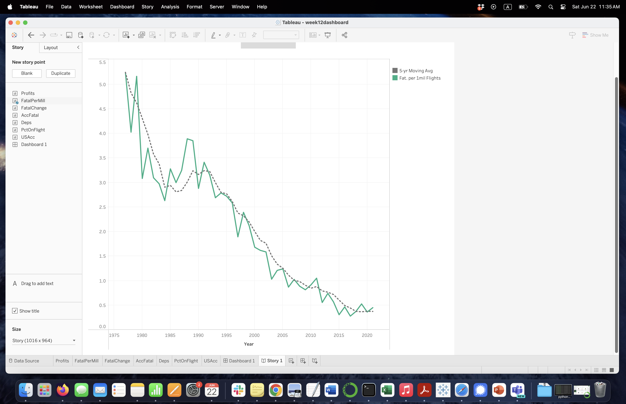

Global Airline Fatalities
Fatal airline accidents have continued to decline since the 1990s
In the last few years, there have been fewer than 0.5 deaths per million flights

Slide 5
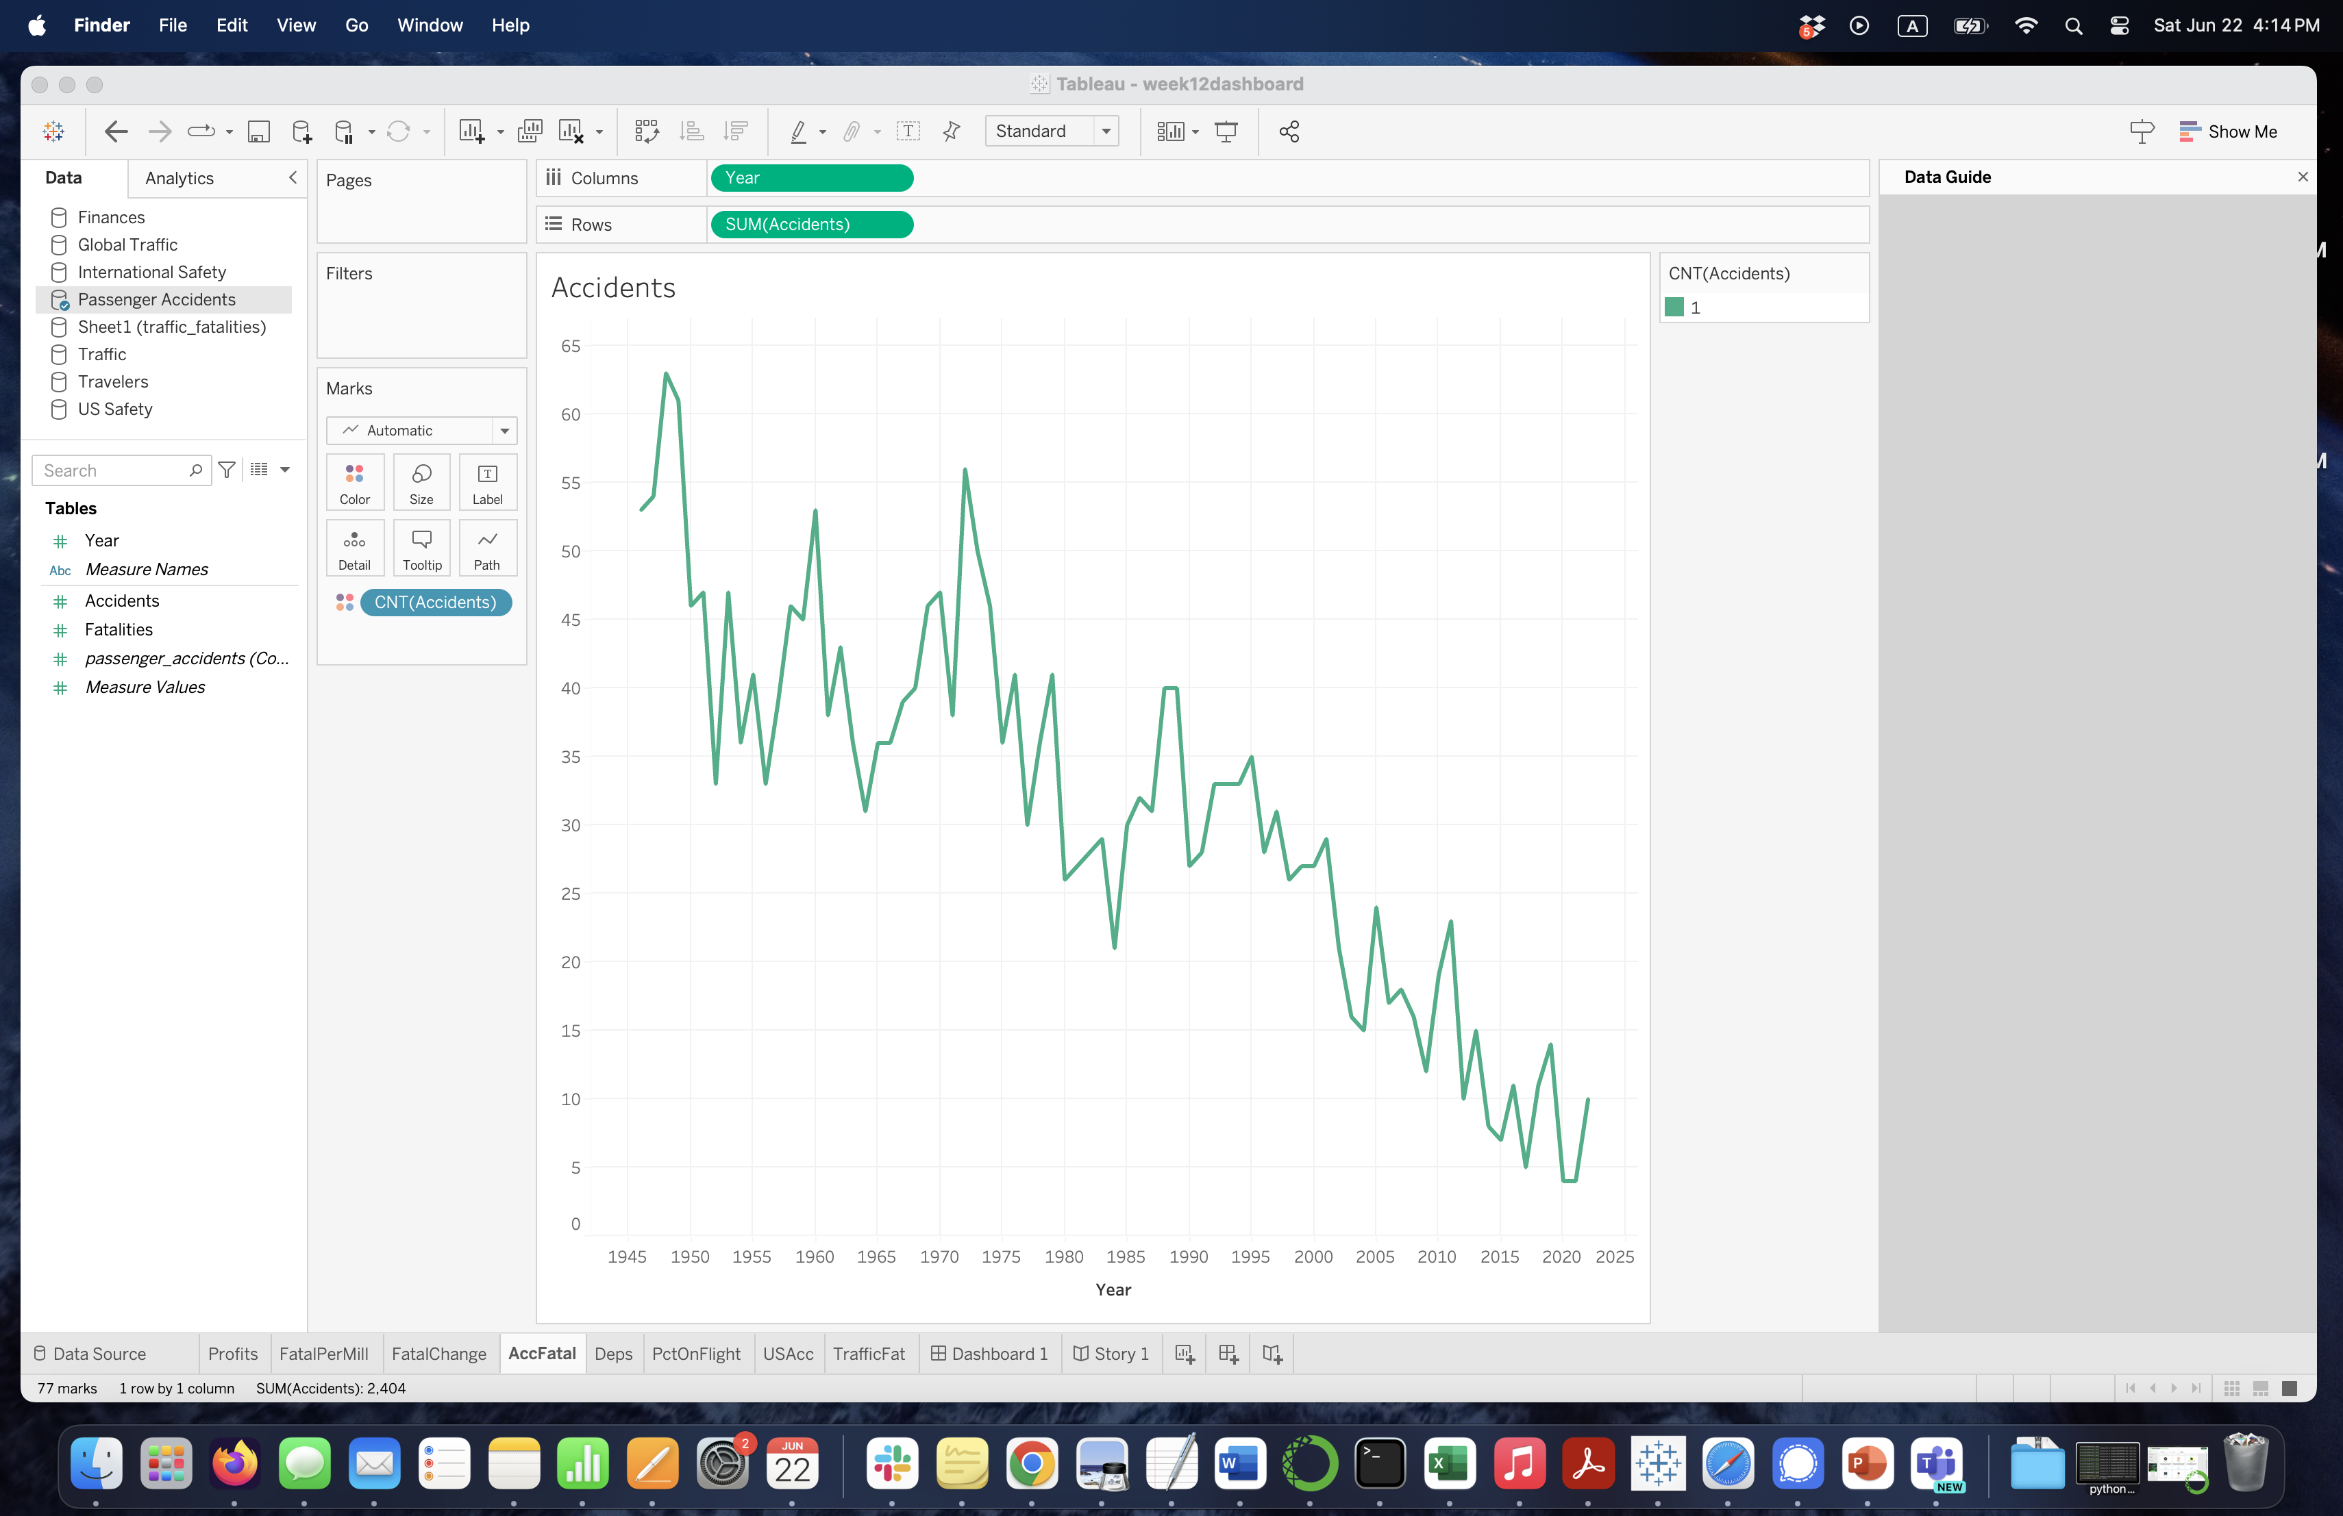
Airline Fatal Accidents
Similarly, the total number of fatal accidents has been declining
In 2011 there were 23 fatal accidents
In 2021 there were only 4

Slide 6
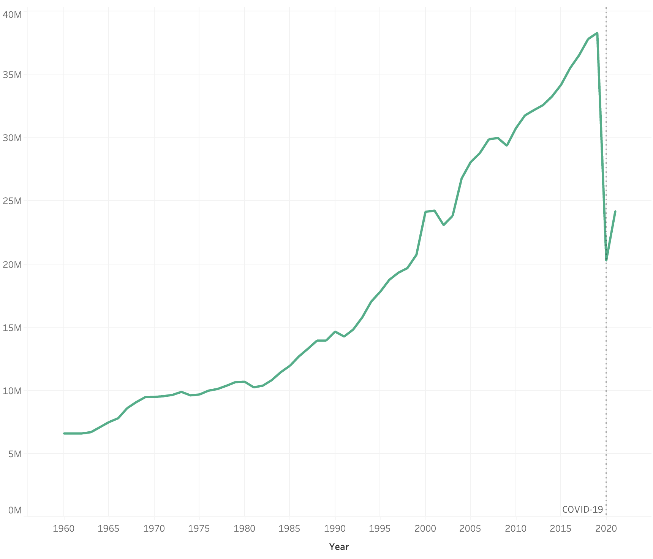
Global Departures
Along with fewer accidents, total departures have continued to increase
There was a peak of 38.3 million in 2019
Departures took a dip during the pandemic but seem to be increasing again

Slide 7
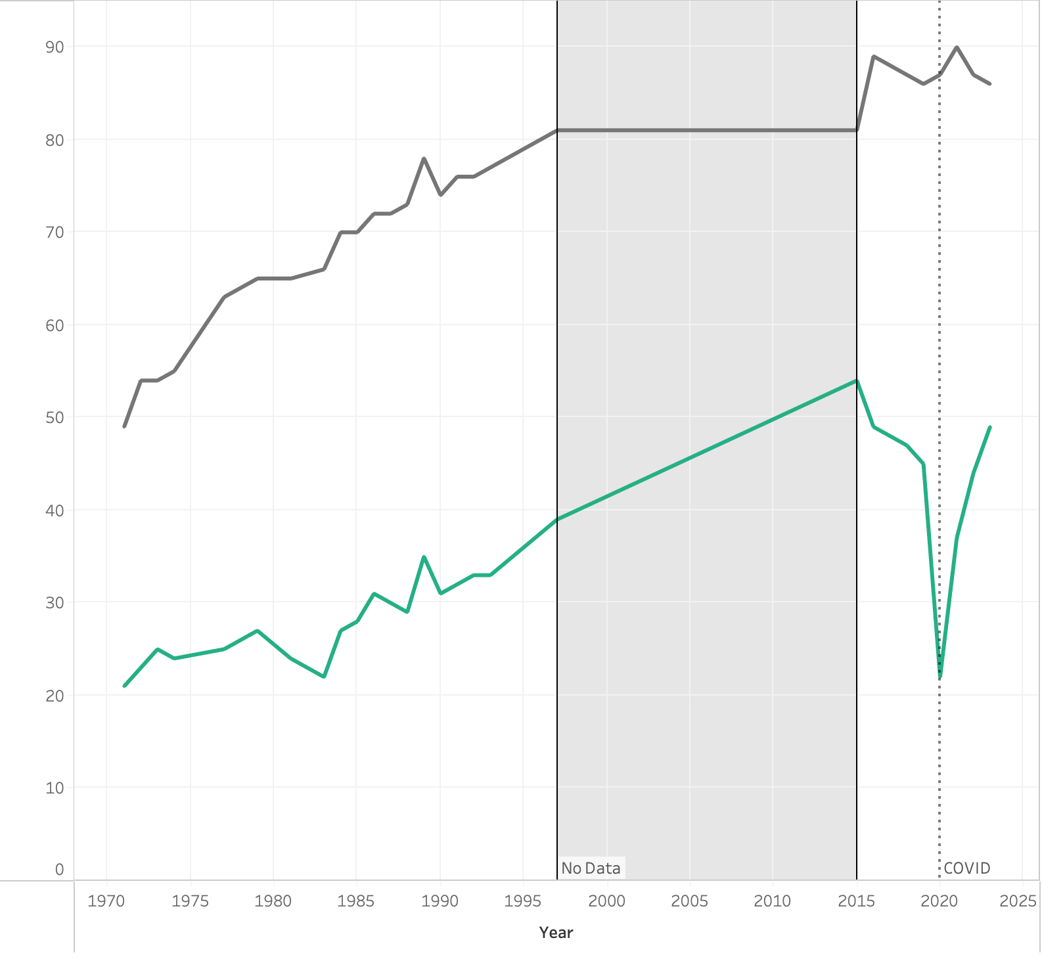
Percentage Who Have Flown
The percentage of those in the US who have flown has also been increasing over time
In 1973 only 54% of people had ever flown
In 2023 over 86% of people have flown
Those flying in the past year has increased rapidly since the pandemic, more than doubling in the past 3 years

Slide 8
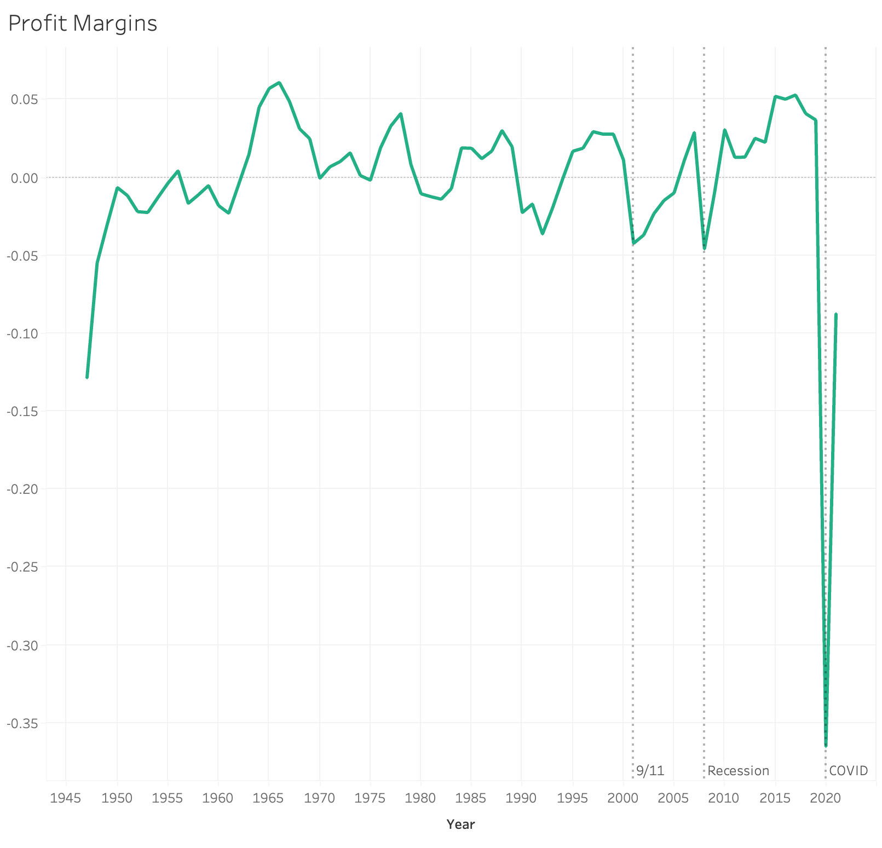
SafeAirlines Profit Margins
Profit margins had been trending upward until the pandemic
Major events seem to have a significant impact on profits

Slide 9
Major Airline Fatalities in the US (2022)
Miles Traveled (mil.) | 5,000+
Fatalities | 0
Fatalities / 100,00 ppl | 0
Deaths / 100mil mi. | 0

Slide 10
Closing Thoughts
Aviation is safer than ever before
In the past 30 years, the number of fatalities per million flights has dropped from 4 to 0.4
More people are flying than ever before
The number of departures increased to a peak of over 38 million in 2019
Profits show signs of recovery
Although profits plummeted during the pandemic, the percentage of people flying has continued to increase
Conclusion: The media hype is overblown.

Slide 11
Sources
https://github.com/fivethirtyeight/data/tree/master/airline-safety
https://asn.flightsafety.org/
https://www.airlines.org/impact/
http://web.mit.edu/airlinedata/www/Traffic&Capacity.html
https://www.nhtsa.gov/data

